Slide 1

Piz Bernina Helpline
Digitalisation of Business Processes

Slide 2

Table of Content
1
Idea
As Is Process
To Be Process
Approach (Persona & User Journey) (demo???)
Service Integrations
Further Development /Desired (e.g. Uber)
2

Slide 3

Idea of Piz Bernina Helpline
Google it!
Piz Bernina Helpline
See a doctor
Ask friends
Everyone had already an accident, disease or pain.
How did you get help?
Get fast help with our Piz Bernina Helpline

Slide 4
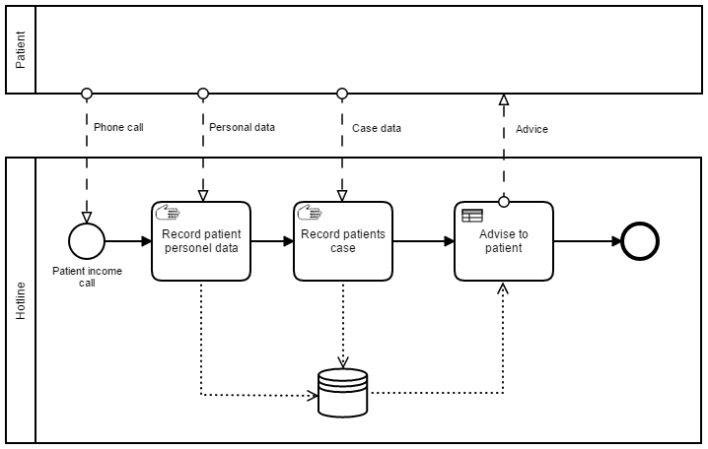
As Is Process
+
Personal Contact
Human Conversation
High fixed costs
Not scalable
Slow case processing
-

Slide 5
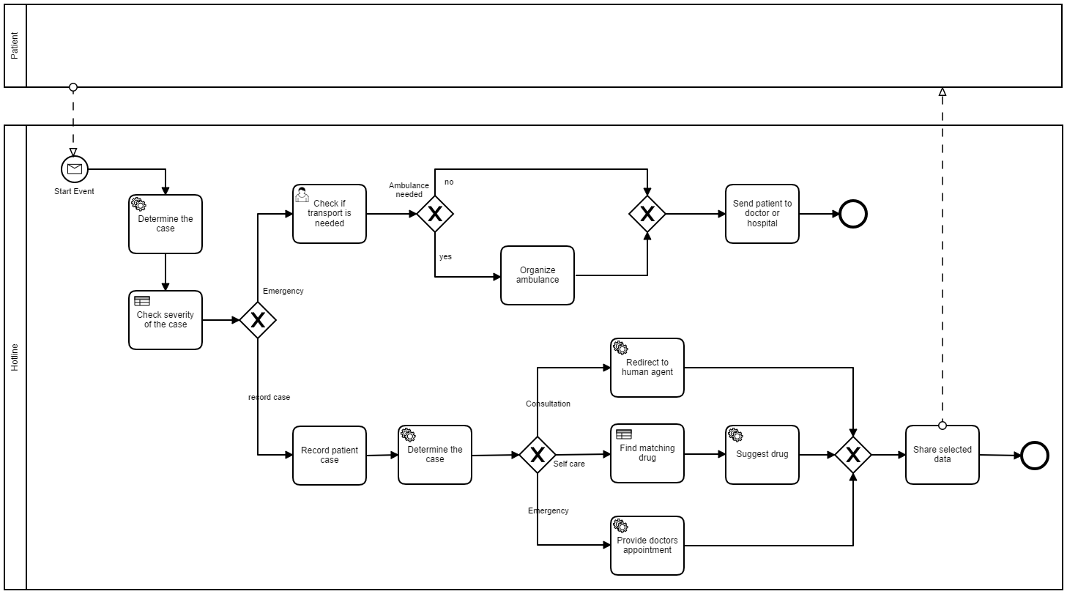
To Be Process

Slide 6

Use case: vacation
Name: Jeanine Senn
Age: 27 years old
Location: Currently on vacation in Brazil
Characteristics: Curious, spontaneous, spending a lot of time on social media, high IT affinity
”Hello! I am actually on holiday and enjoying my stay in Brazil. In order to make this trip unforgettable I wanted to do something special. I decided to get a piercing and went to a tattoo shop. After a few days, a friend of mine called attention and told me that my ear is red.”

Slide 7
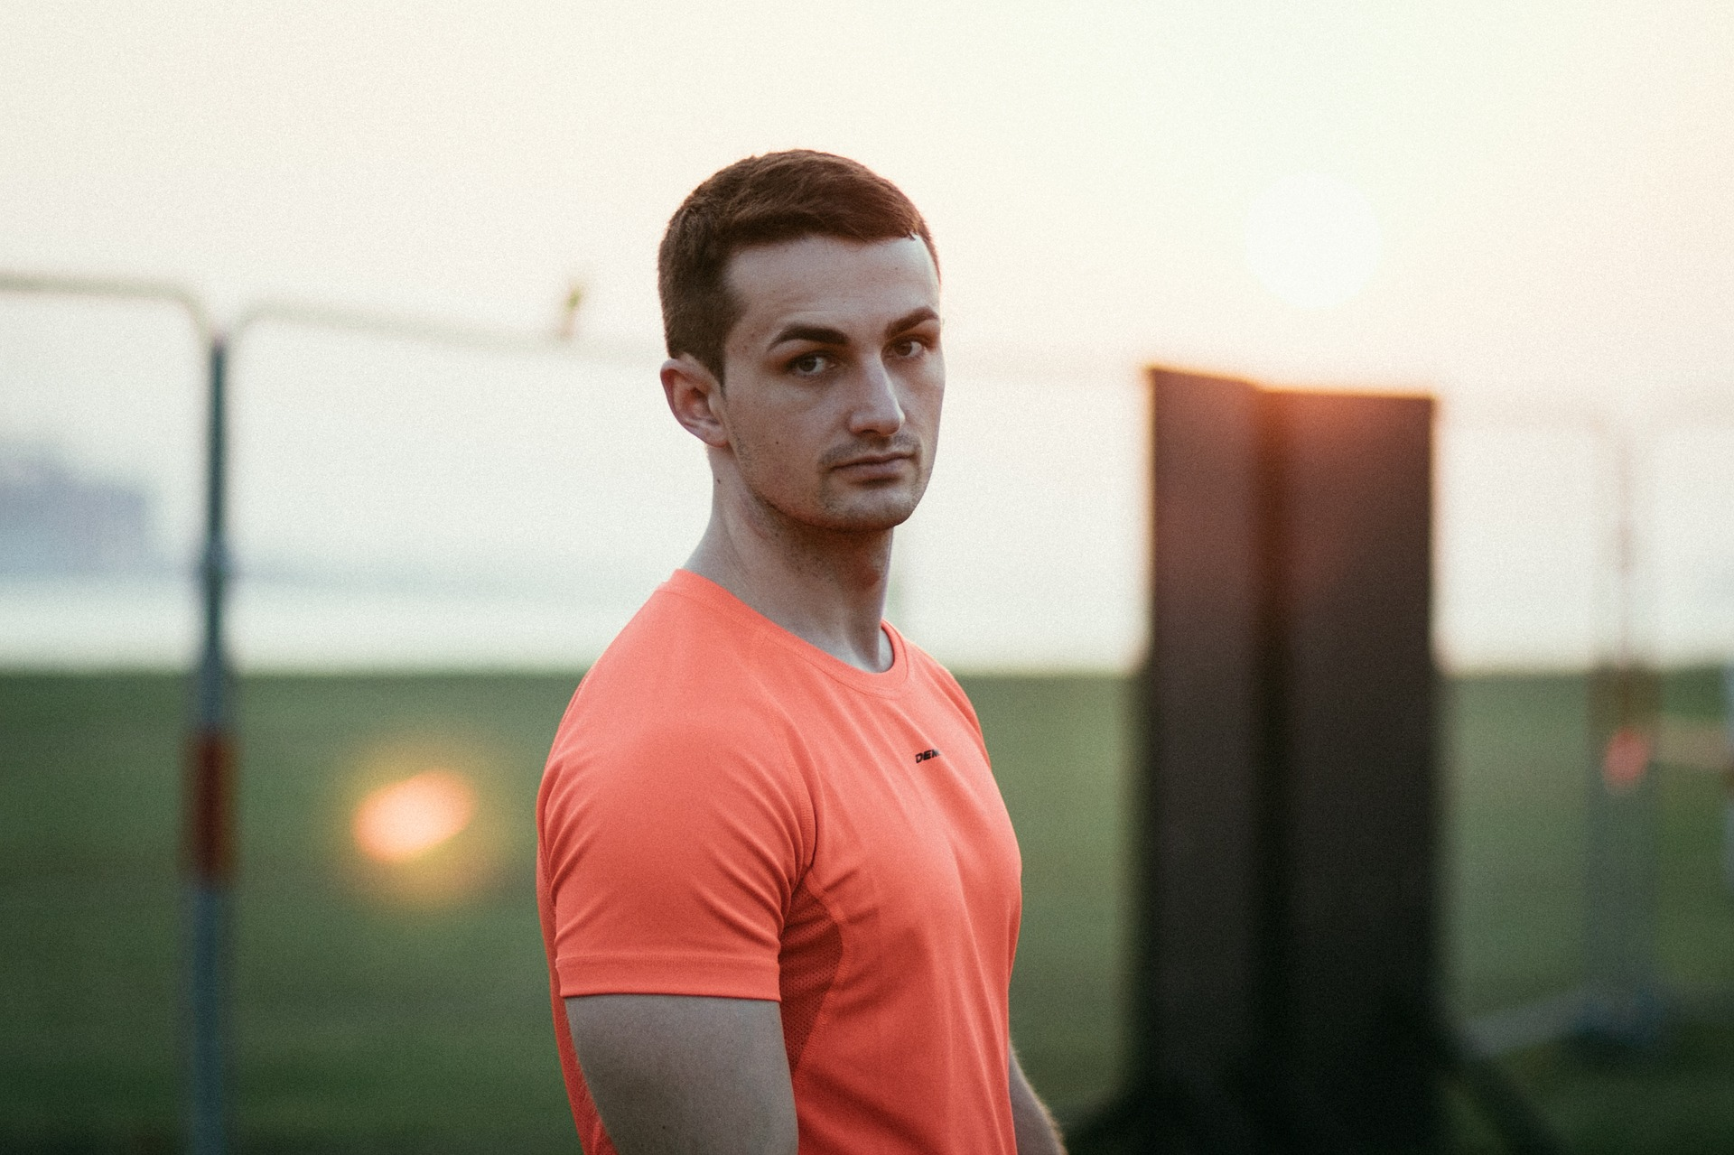
Use case: soccer player
Name: Jonas Draxler
Age: 23 years old
Location: In the apartment in Bayern
Characteristics: Ambitious, athletic, loves to have new gadgets
”Hello everyone! My name is Jonas and I am a professional soccer player in Germany. I had a clash with a teammate during our last training session. After I have been at my place I felt bad. I just wanted to go to bed, but before I needed to know whether there is something serious.”

Slide 8

Use case: business trip
Name: John Weber
Age: 58 years old
Location: Business trip in Berlin
Characteristics: Ambitious, always on the way, enjoys meeting up with friends, wants to be independent
”Hi…(John is coughing)..I am sorry but I really feel bad. Since two weeks I am in Berlin for a innovation project. Three days ago I met some friends for a beer. One of my friends has just recovered from a virus infection. I think it was not the best idea to meet him because …(John is coughing)..I feel horrible. Should I see a doctor?”.

Slide 9


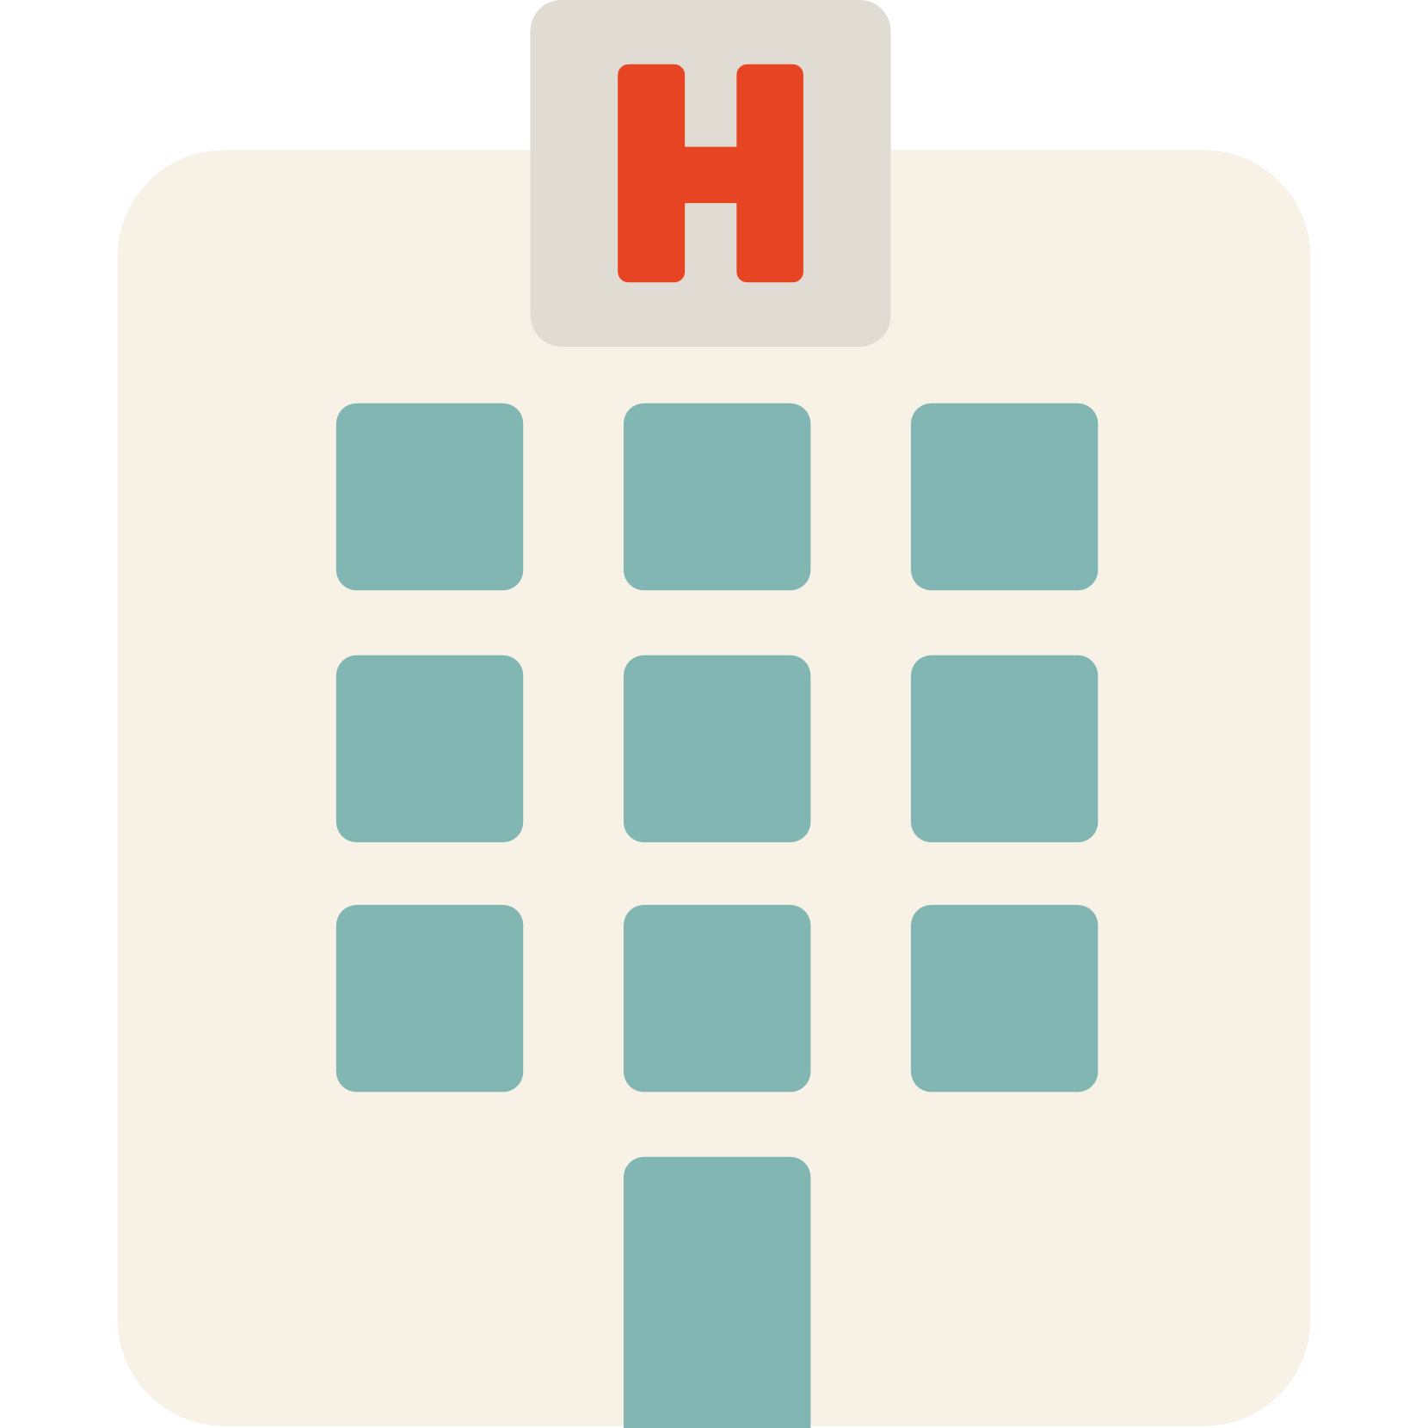



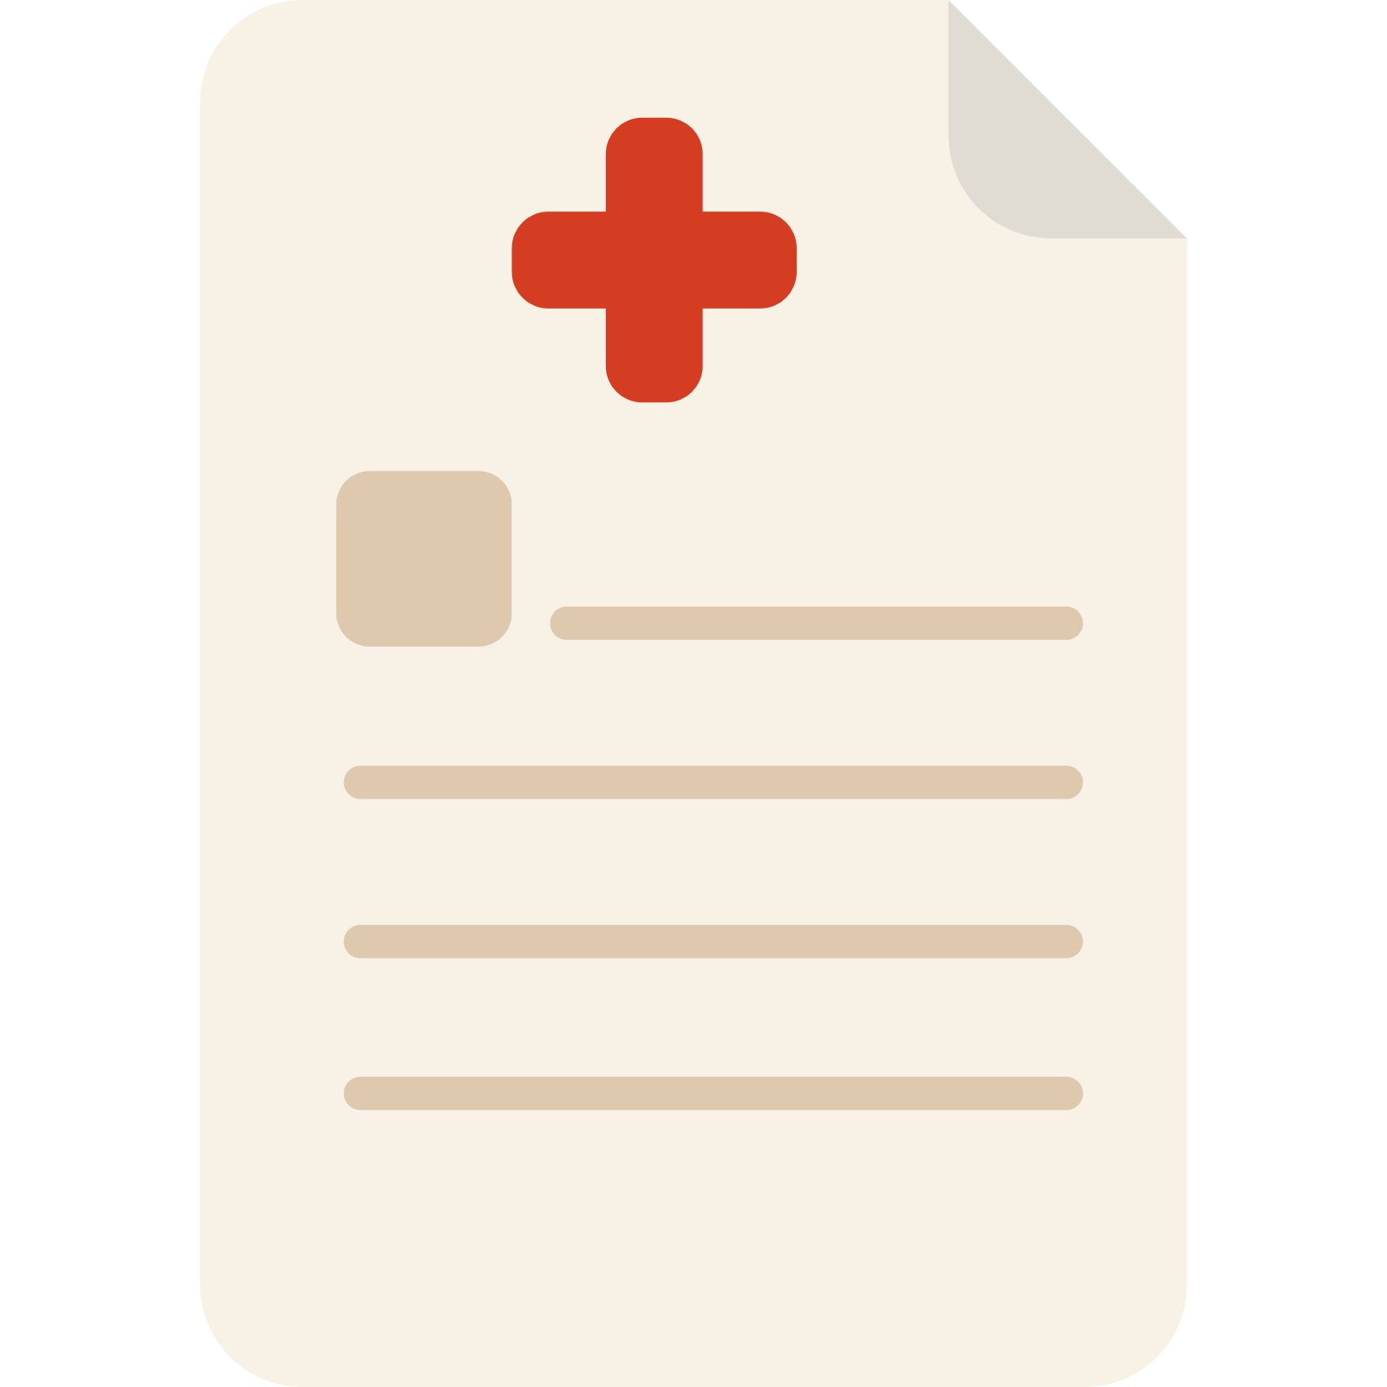









Service Integrations
Symptoms and Patient Data
Consultation
Emergency
Self Care
Customer Complaints
Physical Injury
DMN
DMN

Slide 10
Further development
Collected data can be shared with other institutions
Patient can check the availability of required drug or can place an order, if drug is not in stock
Patient has access to the time schedule of the doctor and can book an appointment
If required, a patient can book an Uber or Cab to see the doctor

Slide 11
V 2.0

Slide 12
